Slide 1
EMPLOYEE ATTRITION ANALYSIS AND PREDICTION
- AKASH P

Slide 2
AGENDA
Introduction
Problem Statement
About Data
Exploratory Data Analysis
Machine Learning

Slide 3
INTRODUCTION INTRODUCTION What is this Project About? This project seeks to understand the factors that contribute to employee attrition and to forecast which employees are more inclined to leave the company.

Slide 4
What is Employee Attrition?
Employee Attrition refers to the natural process of employees leaving a company and
needing to be replaced. It can occur due to various reasons such as resignation,
retirement, termination, or various reasons. Attrition is a common phenomenon in every
organization, but excessive or unexpected attrition rates can pose challenges for
business.
Employees come and go in every company, that's normal attrition.
But if too many people leave suddenly, it can cause problems like,
More money spent finding new people
Important company knowledge being lost
Other employees feeling down
Work getting messed up

Slide 5
PROBLEM STATEMENT
Acme Corporation, a leading tech company, is facing a significant challenge with
employee turnover. The HR department is concerned about the increasing rate of
attrition, as it negatively impacts team dynamics, project continuity, and overall
company morale.
To address this issue, Acme Corporation wants to leverage data analytics and
machine learning to understand the factors influencing employee turnover and predict
which employees are likely to leave in the near future.
GOAL
To examine the trends and underlying factors contributing to employee attrition, and
to develop a Binary Classification Model for predicting whether an employee is likely
to leave or stay with the company.

Slide 6
ABOUT DATA
The available dataset is accessible in " .csv" format, containing
employee demographic information.
Number of Rows in the dataset - 1470
Number of Columns in the dataset - 35

Slide 7
Column Description:
Age: The age of the employee.
Attrition: A binary variable indicating whether the employee has left the company
(1) or is still employed (0).
BusinessTravel: The frequency and nature of business-related travel (e.g.,
"Travel_Rarely, " "Travel_Frequently, " "Non-Travel").
DailyRate: The daily rate of pay for the employee.
Department: The department to which the employee belongs (e.g., "Sales, "
"Research & Development, " "Human Resources").
DistanceFromHome: The distance of the employee's residence from the workplace.
Education: The employee's level of education (e.g., "1: 'Below College' , "
"2: 'College' , " "3: 'Bachelor' , " "4: 'Master' , " "5: 'Doctor').
EducationField: The field in which the employee's education lies (e.g., "Life
Sciences, " "Medical, " "Marketing").
EmployeeCount: Number of employees, typically used for internal recordkeeping.
EmployeeNumber: A unique identifier for each employee.

Slide 8
Column Description:
EnvironmentSatisfaction: The level of satisfaction with the work environment on
a scale.
Gender: Gender of the employee.
HourlyRate: The hourly rate of pay for the employee.
JobInvolvement: The degree to which the employee is involved in their job.
JobLevel: The level or rank of the employee's position.
JobRole: The specific role or title of the employee's job.
JobSatisfaction: The level of satisfaction with the job on a scale.
MaritalStatus: The marital status of the employee.
MonthlyIncome: The monthly salary of the employee.
MonthlyRate: The monthly rate of pay for the employee.
NumCompaniesWorked: The number of companies the employee has worked for.

Slide 9
Column Description:
Over18: Indicates whether the employee is over 18 years old.
OverTime: Whether the employee works overtime or not.
PercentSalaryHike: The percentage increase in salary received by the employee.
PerformanceRating: Rating of the employee's performance.
RelationshipSatisfaction: The level of satisfaction with relationships at the
workplace.
StandardHours: Standard number of working hours per week.
StockOptionLevel: The level of stock options provided to the employee.
TotalWorkingYears: The total number of years the employee has been working.
TrainingTimesLastYear: The number of training sessions the employee attended
last year.
WorkLifeBalance: The balance between work and personal life.

Slide 10
Column Description:
YearsAtCompany: The number of years the employee has been with the
current company.
YearsInCurrentRole: The number of years the employee has been in their
current role.
YearsSinceLastPromotion: The number of years since the last time the
employee was promoted.
YearsWithCurrManager: The number of years the employee has been working
under the current manager.

Slide 11
EXPLORATORY DATA
ANALYSIS
(EDA)

Slide 12
Feature and Target variables
Feature Variables
'Age' , 'BusinessTravel' , 'DailyRate' , 'Department' , 'DistanceFromHome' , 'Education' ,
'EducationField' , 'EmployeeCount' , 'EmployeeNumber' , 'EnvironmentSatisfaction' ,
'Gender' , 'HourlyRate' , 'JobInvolvement' , 'JobLevel' , 'JobRole' , 'JobSatisfaction' ,
'MaritalStatus' , 'MonthlyIncome' , 'MonthlyRate' , 'NumCompaniesWorked' , 'Over18' ,
'OverTime' , 'PercentSalaryHike' , 'PerformanceRating' , 'RelationshipSatisfaction' ,
'StandardHours' , 'StockOptionLevel' , 'TotalWorkingYears' , 'TrainingTimesLastYear' ,
'WorkLifeBalance' , 'YearsAtCompany' , 'YearsInCurrentRole' , 'YearsSinceLastPromotion' 'YearsWithCurrManager'
Target Variable
'Attrition'

Slide 13
Data Quality Assessment
The dataset doesn't have any repeated (Duplicates) or missing information (Null Values).
The categories are right and don't contain mistakes or irrelevant stuff.
The data types are also in an appropriate manner.
Data looks good and organized

Slide 14
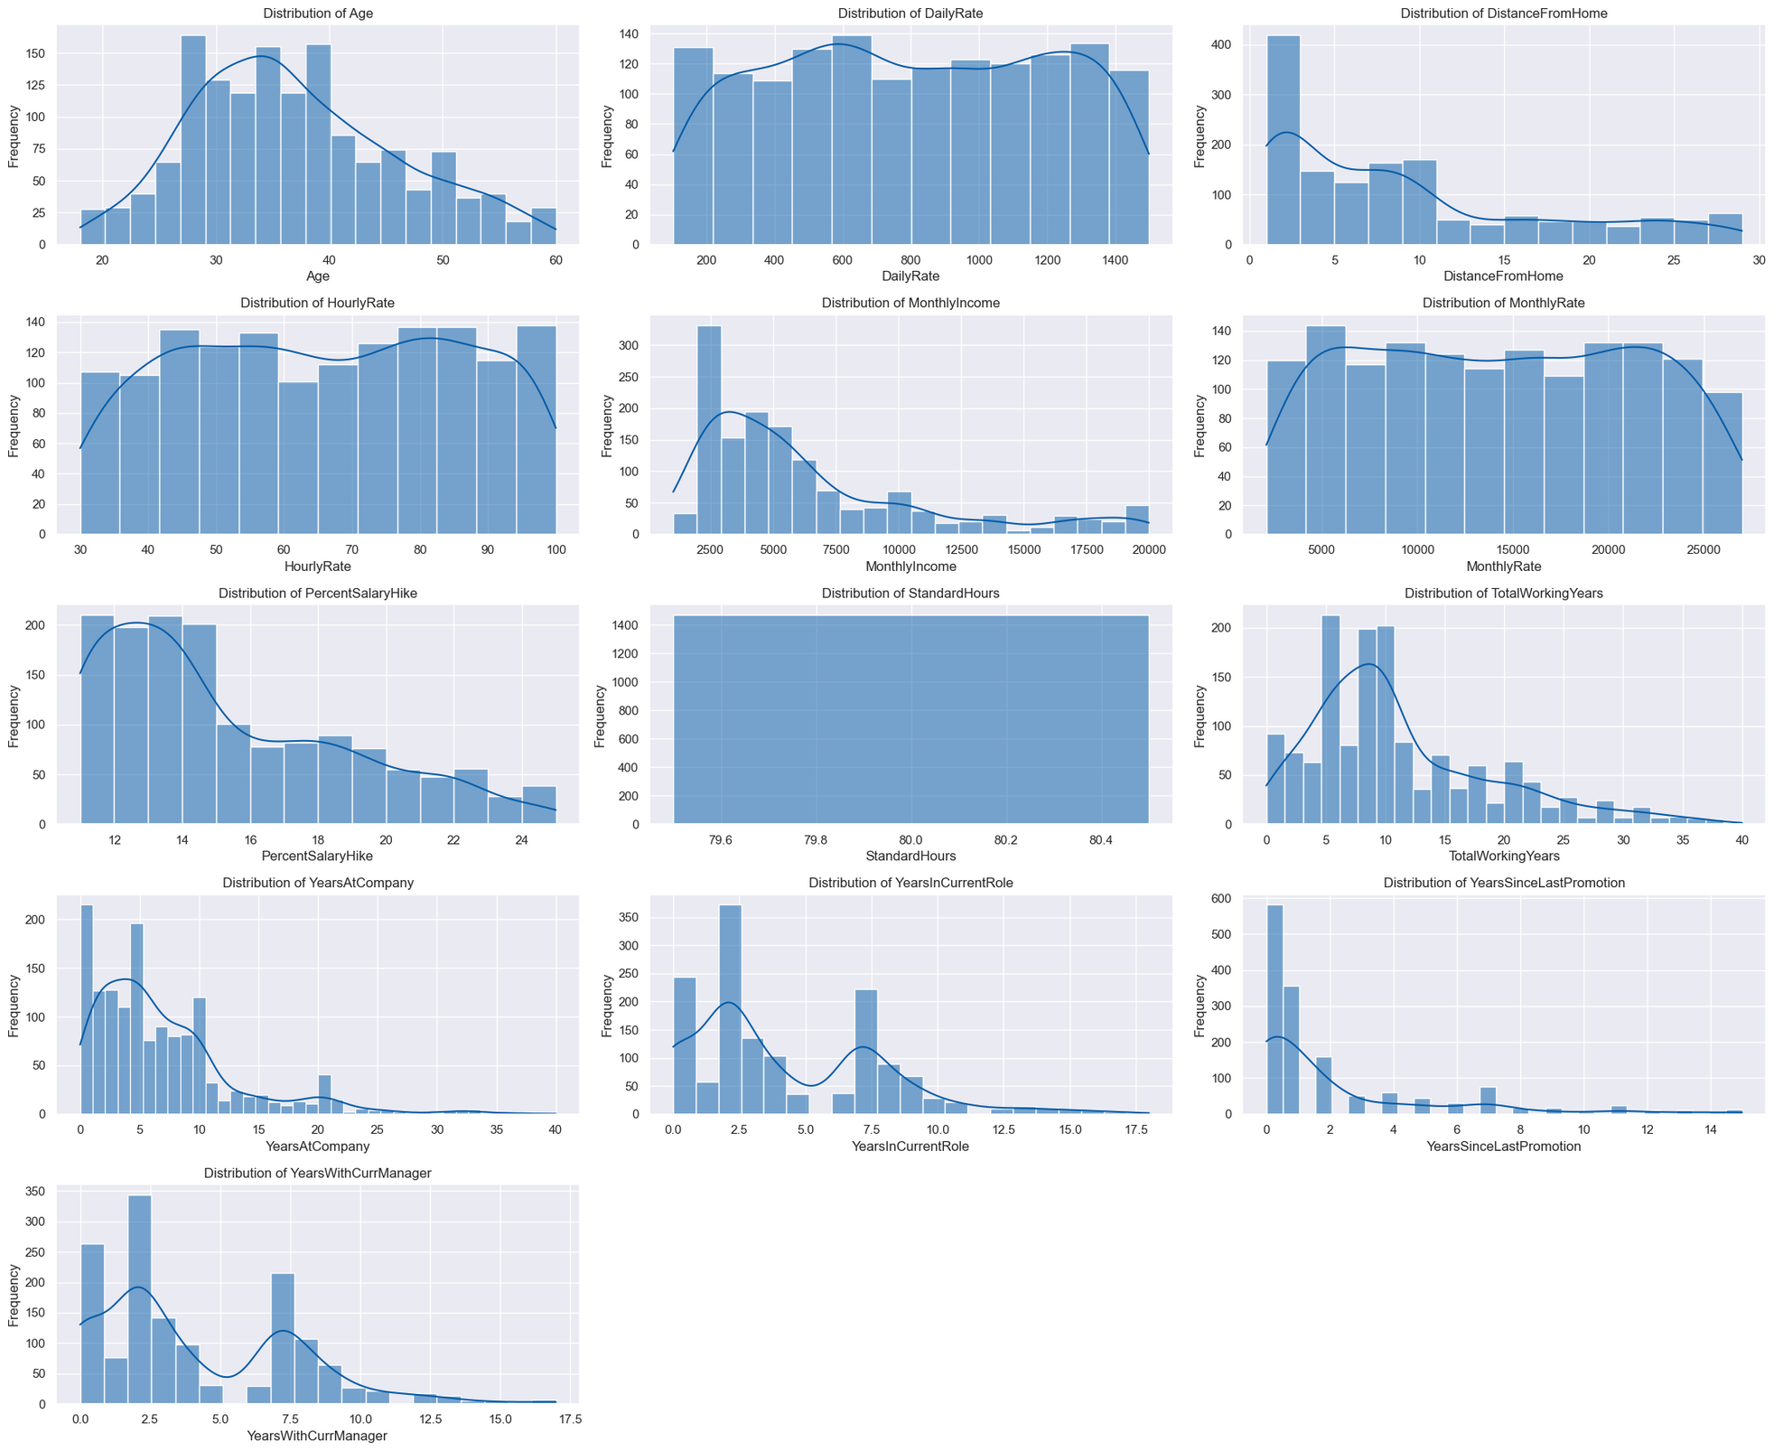
Distribution of Continuous Numerical Variables

Slide 15

Distribution of Continuous Numerical Variables

Slide 16
Observations:
Only the "Age" column looks like normally distributed.
The columns "DailyRate" , "HourlyRate" and "MonthlyRate" are almost uniformly
distributed in this dataset.
The columns
"DistanceFromHome" , "MonthlyIncome" , "PercentSalaryHike" , "TotalWorkingYears" ,
"YearsAtCompany" and "YearsSinceLastPromotion" follows right skewed distribution.
"YearsInCurrentRole" and "YearsWithCurrManager" columns shows bimodal
distribution.
"StandardHours" column remains consistent across all data points without significant
variation.

Slide 17
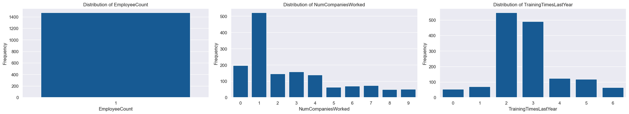
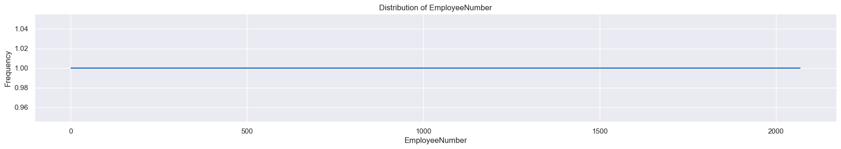
Distribution of Discrete Numerical Variables

Slide 18
Observations:
The data in the "NumCompaniesWorked" column indicates that the majority of
employees have experience working in just one company, with the next highest
frequency being those who have not worked in any previous companies.
"TrainingTimesLastYear" column shows that the employees who attended 3 training
sessions last year had a higher frequency, followed by the employees who attended 3
sessions.
Since the number of unique employee number is equal to the number of entries in the
dataset, it suggests that the employee number are evenly distributed throughout the
dataset.
"EmployeeCount" column remains consistent across all data points without significant
variation.

Slide 19
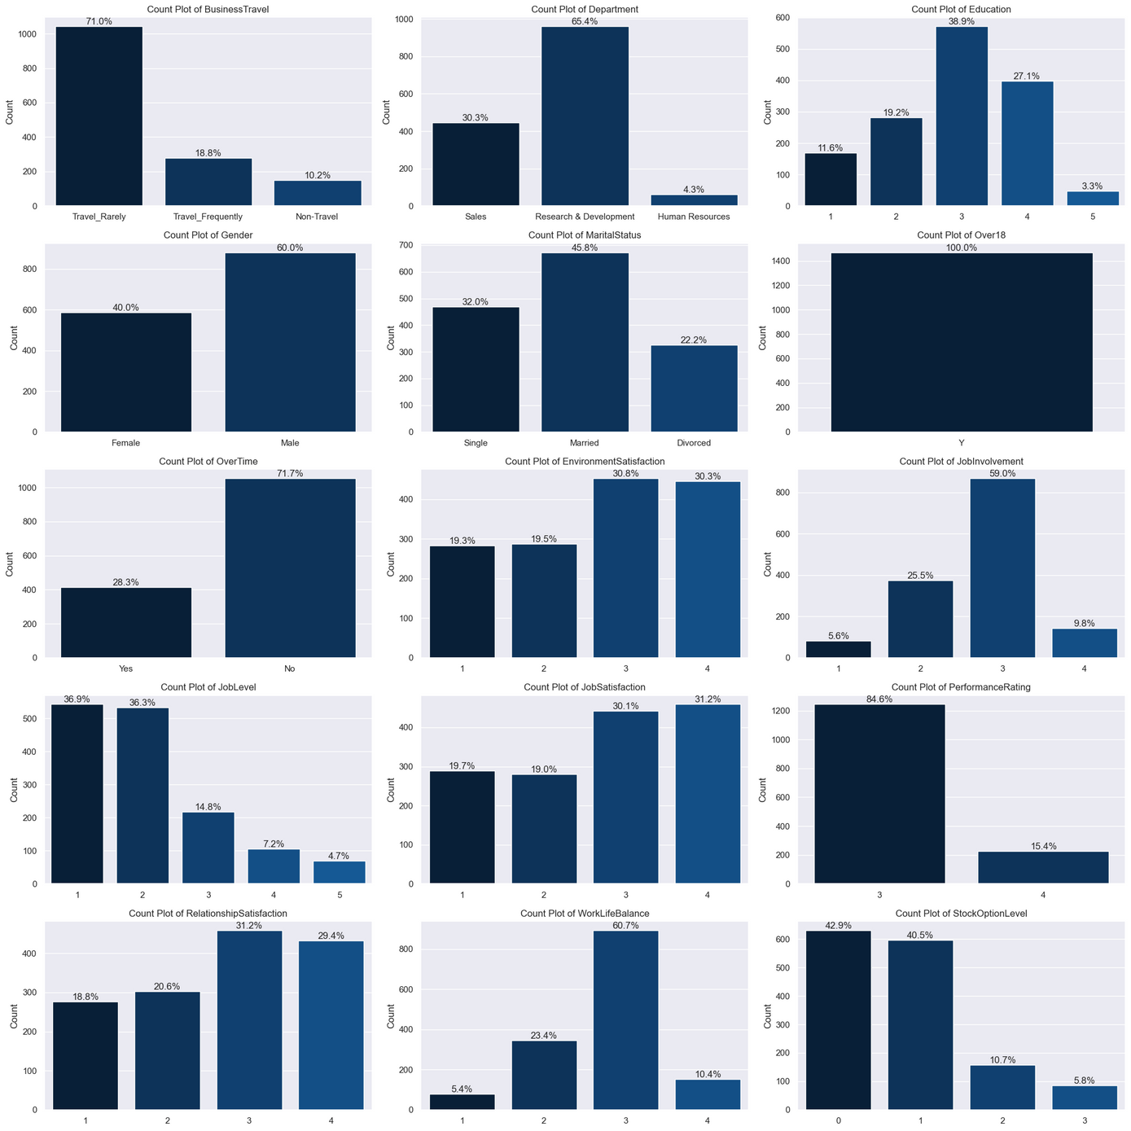
Frequency Distribution of Categories in Each Categorical Column

Slide 20
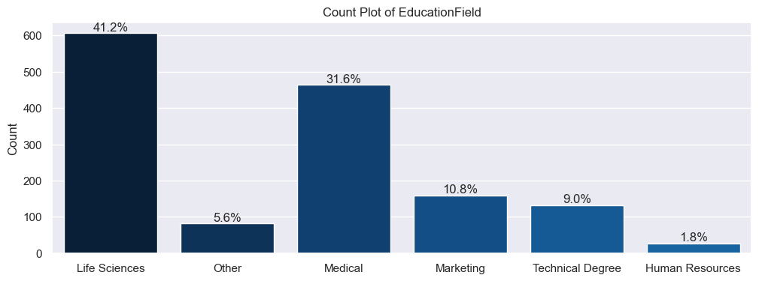
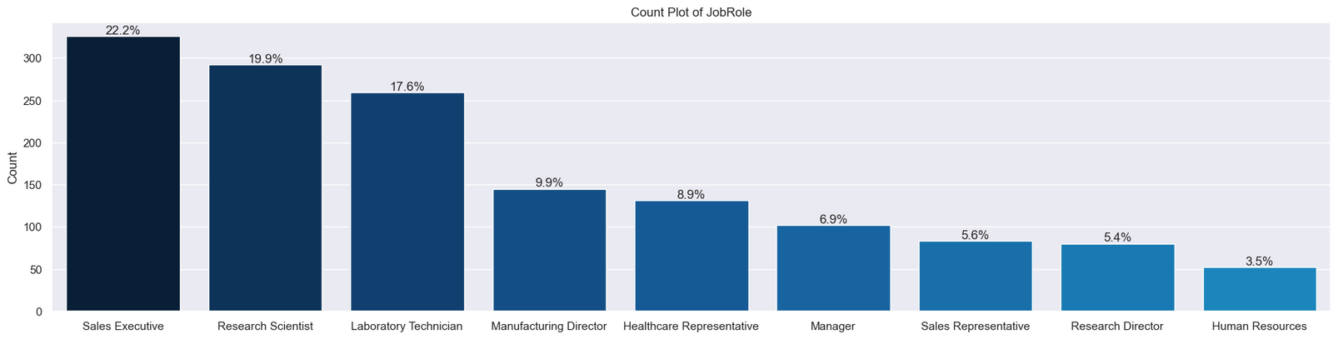
Frequency Distribution of Categories in Each Categorical

Slide 21
Observations:
Among employees who travel for business, the percentage that travels rarely is
70.95%, while those who don't travel at all account for 10.2%.
For about 65.4% employees belongs to Research and Development.
38.9% of employees have successfully completed their bachelor's degrees, while a
smaller proportion, 3.3%, have achieved their doctorates.
Male employees dominate with 60% of the workforce, leaving the remaining
percentage occupied by females.
45% of the workforce is married, while singles and divorced individuals collectively
make up 54.2%.
All employees in this dataset are over the age of 18 years.
71.7% of individuals are working overtime.

Slide 22
Observations:
When it comes to evaluating the working environment, a significant majority,
accounting for 61.1% of respondents, have given ratings of 3 and 4 stars,
indicating a generally positive perception. Conversely, 38.9% of respondents have
provided ratings of 1 and 2 stars, suggesting a less favorable outlook on their
work environment.
With 59% of respondents choosing this rating, it suggests that a majority of the
respondents feel moderately satisfied with their job.5.6% employees are very
dissatisfied with their job.
73.2% of employees are in job levels 1 and 2, it indicates that a significant portion
of the workforce occupies entry-level or junior positions. Only 4.7% are in high
level jobs.
Only 15.4% of employees have received a 4-star performance rating, with the
remainder being rated at 3 stars.

Slide 23
Observations:
31.2% of employees rated their satisfaction with workplace relationships as 3 and
18.% employees rated as 1.
Out of all the employees, only 10.4% reported having a good work-life balance,
while the majority, comprising 60.7%, indicated a moderate work-life balance.
Additionally, 5.4% of employees expressed having a poor work-life balance.
83% of employees are in stock option levels 0 and 1, it shows that a large majority
of the workforce receives either minimal or moderate stock options. Only a small
fraction of the workforce (5.8%) receives exceptional stock options.
22.2% of the workforce comprises sales executives, making them the largest group,
followed by 19.9% who are research scientists, and so forth.
Among all employees, those from the life science education field contribute the
highest percentage, accounting for 41.2% of the total.

Slide 24
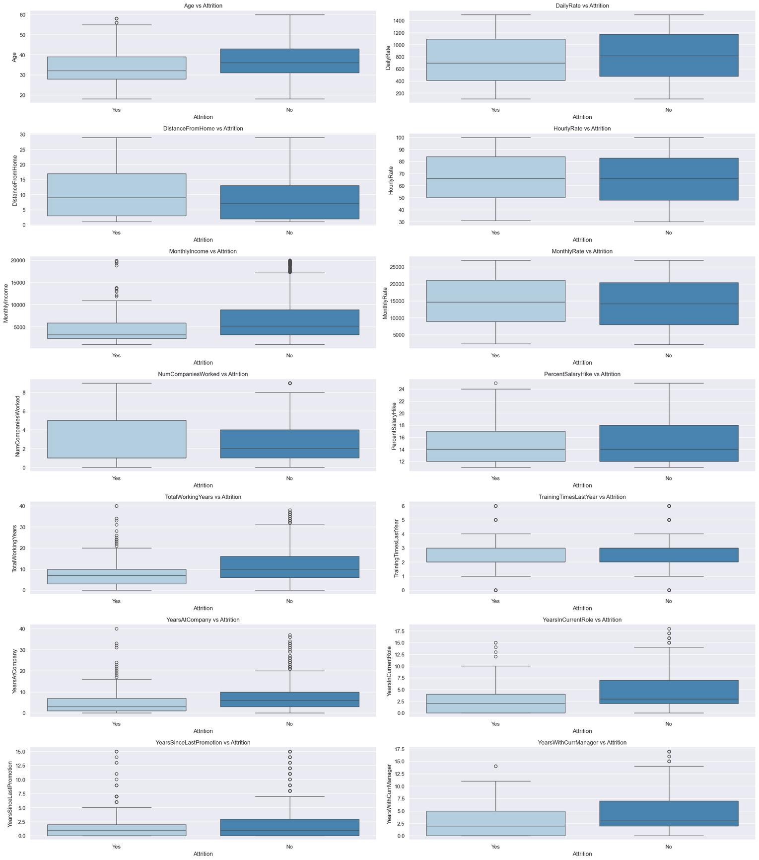
Relationship Between Numerical Columns and the Target Variable

Slide 25
Inference:
The Box plot suggests that employees with age below 40 are more likely to
leave the company.
Employees who have a significant distance between their home and the
office tend to leave the company.
Employees with lower monthly income may exhibit a significant tendency to
leave the company.

Slide 26
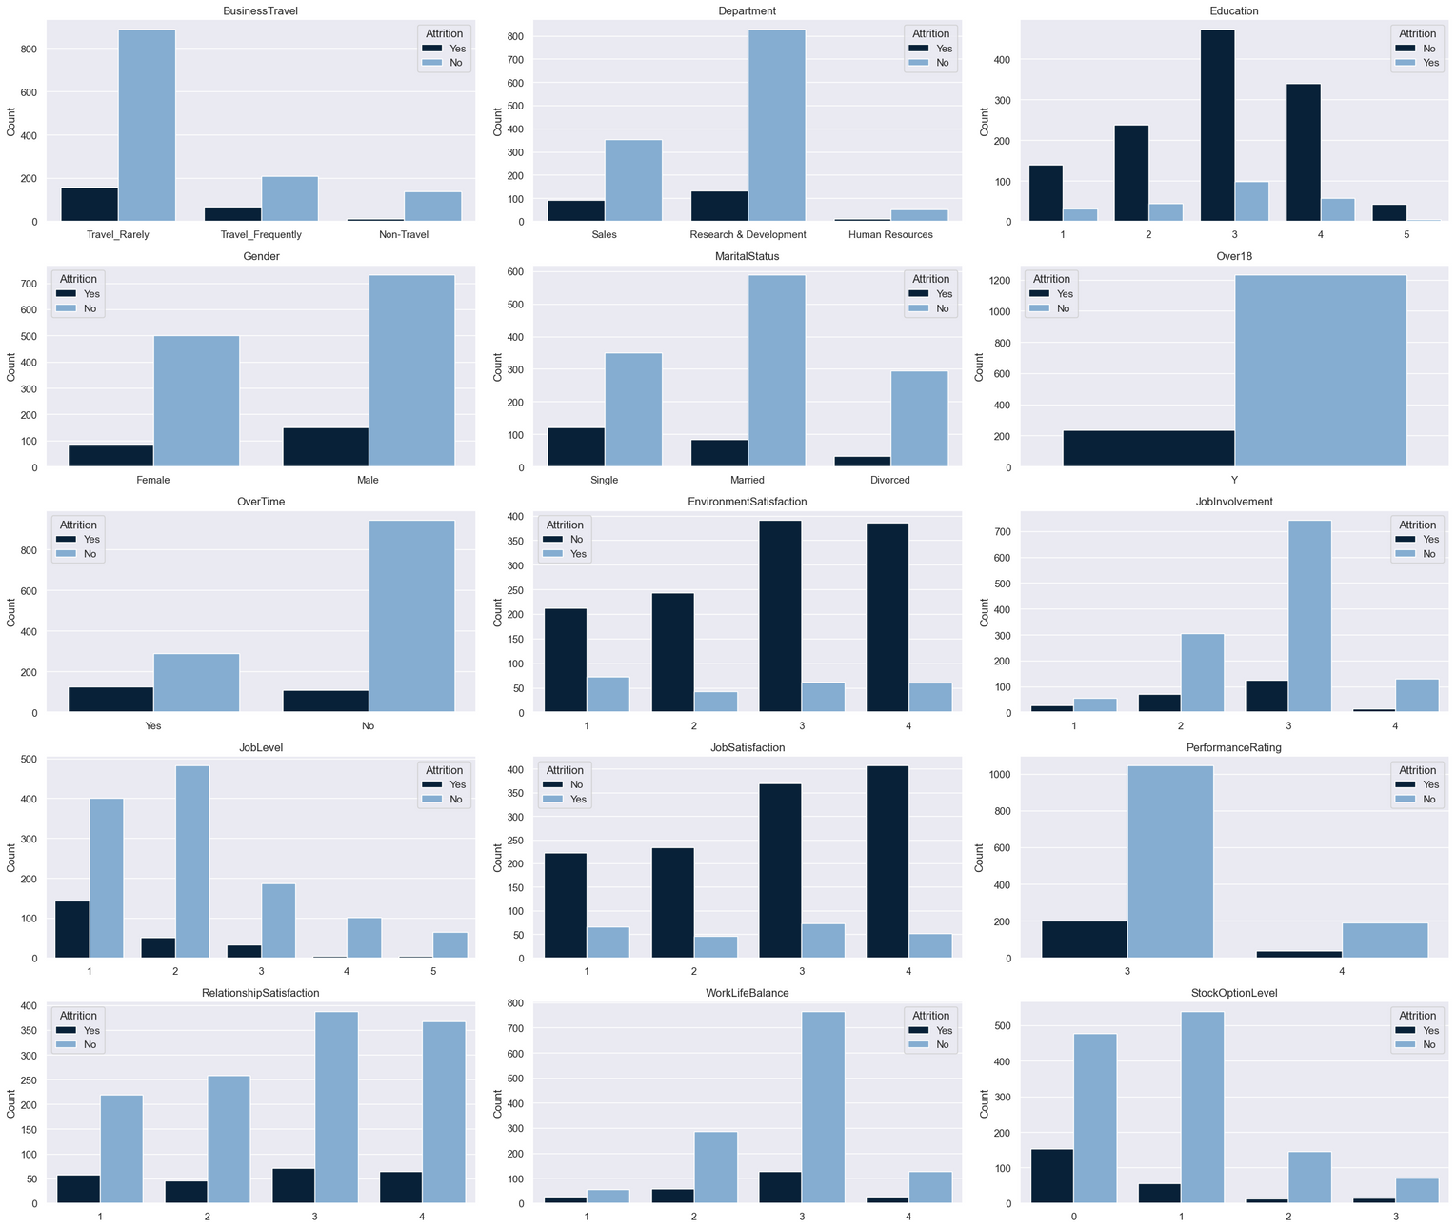
Distribution of Target in Each Category of Categorical Column

Slide 27
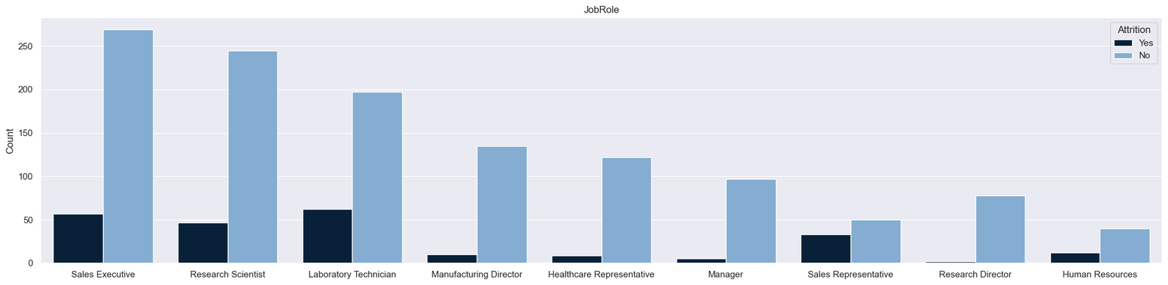
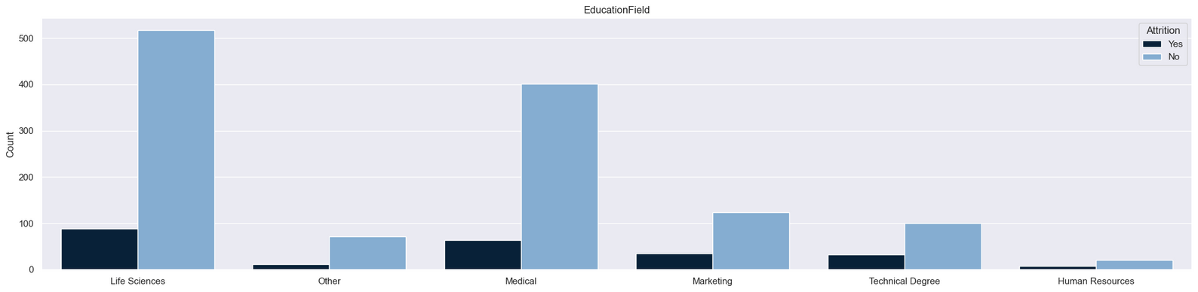
Distribution of Target in Each Category of Categorical Column

Slide 28
Inference:
Employees designated as "Travel_rarely" are subject to attrition.
Bachelor's degree holders are more likely to depart from the company.
Employees who studied "Life Sciences" are more prone to leaving the
company.
"Single" employees are leaving the company more frequently than those in
other marital status categories.
Employees who rated their level of satisfaction with the environment as 1 or
2 are departing from the company more often than those who rated it as 3
or 4.The same result is for "JobStatisfaction" too

Slide 29
Inference:
Level 1 job employees are likely to leave the company, followed by level 2,
and level 3.
Employees with performance rating 3 are subject to attrition.
The number of employees with stock option level 0 leaving the company is
higher compared to those with other levels of stock options.
Laboratory technicians are departing from the company at the highest rate,
followed by sales executives.

Slide 30
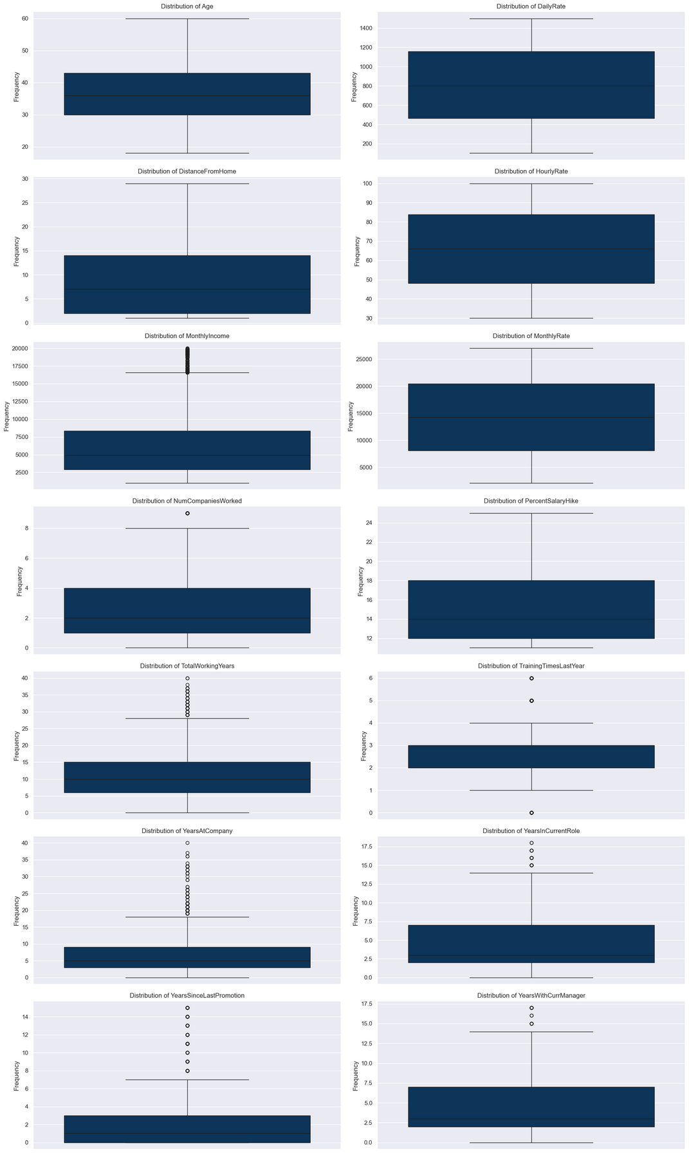
Exploring Outliers

Slide 31
Observations:
Outliers are seen in all the numerical columns except
"Age" , "Dailyrate" , "HourlyRate"and "MonthlyRate".
The "MonthlyIncome" column stands out with the highest count of outliers
among all the columns.
The columns "DistanceFromHome" and "PercentSalaryHike" exhibit fewer
outliers compared to the other columns.

Slide 32
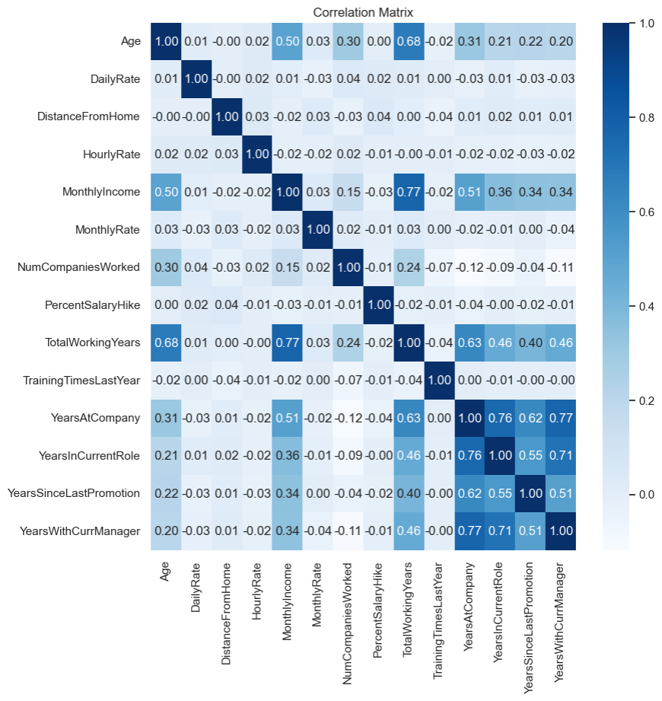
Correlation Among Numerical Variables
It is easily noticeable by seeing the
correlation matrix that many of the
numerical variables are correlated
to each other.
Here exists Multicollinearity
among the variables.

Slide 33
Observations:
There's a remarkably strong positive correlation (0.68) between "Age" and
"TotalWorkingYears". This signifies that as people age, they tend to
accumulate more years of work experience."Age" also shows a positive
correlation with "MonthlyIncome" , though not quite as strong
(0.50).Additionally, there are positive correlations between "Age"and the
number of companies worked at (0.30) and "YearsAtCompany" (0.31).
There is a strong positive correlation (0.77) between "MonthlyIncome" and
"TotalWorkingYears". This means that people with more work experience
tend to earn higher monthly incomes. This is followed by "MonthlyIncome"
and "YearsAtCompany" with a correlation coefficient of 0.51, and with
"YearsInCurrentRole" at 0.36, among others.

Slide 34
Observations:
The correlation coefficient between "TotalWorkingYears" and "YearsAtCompany" is a
substantial 0.63, indicating a strong positive relationship. In simpler terms, people with
more total work experience tend to have longer tenures at their current companies.
Additionally, "TotalWorkingYears" shows a strong positive correlation of 0.46 with both
"YearsInCurrentRole" and "YearsWithCurrManager" , and a correlation coefficient of 0.40
with "YearsSinceLastPromotion".
The strongest positive correlation is between"YearsAtCompany" and
"YearsWithCurrManager" with the current manager is at a high of 0.77. This is closely
followed by "YearsAtCompany" and "YearsInCurrentRole" is of 0.76.
There is a strong positive correlation (0.71) between "YearsInCurrentRole" and
"YearsWithCurrManager". This indicates a tendency for employees to stay in their current
role for as long as they stay with their current manager.

Slide 35
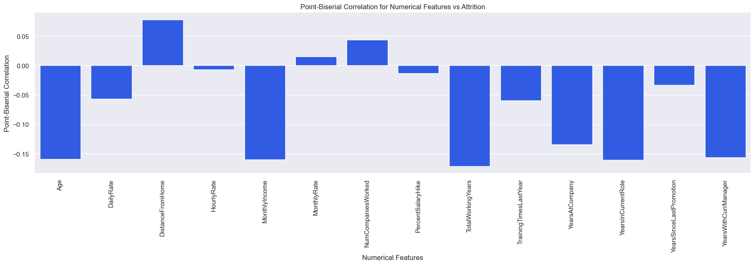
Correlation Between Numerical Features and Target

Slide 36
Observations:
Older employees are less likely to leave the company.
Higher income correlates with lower attrition rates.
Longer total work experience and longer tenure at the current company are
linked to reduced attrition.
Employees who live farther away from the office may be more likely to
leave.
Those who have worked at more companies in the past might be more
inclined to leave.
Shorter durations in the current role and with the current manager correlate
with higher attrition rates.

Slide 37
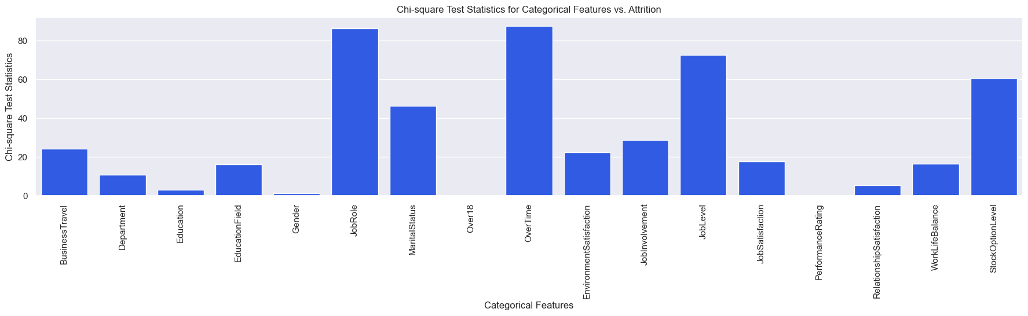
Correlation Between Categorical Features and Target

Slide 38
Observations:
"OverTime" (87.56): Working extra hours significantly increases the chance of employees leaving
the company.
"JobRole" (86.19): Certain job roles have a strong association with employees leaving, possibly
because of differences in workload or job satisfaction.
"JobLevel" (72.53): The level of a person's job affects the likelihood of them leaving. Higher or
lower job levels may influence this.
"StockOptionLevel" (60.60): The number of stock options given to employees has some impact on
whether they stay or leave, although it's not as strong as other factors.
"MaritalStatus" (46.16): Whether someone is married or not slightly affects their likelihood of
leaving their job, but it's not as significant as other factors.
`Meanwhile, the variables "Over 18, " "Performance Rating" , "Gender, " and "Education"
exhibit weaker correlations with the target.`

Slide 39
MACHINE LEARNING

Slide 40
Feature Selection
Columns such as "Age" , "MonthlyIncome" and "YearsInCurrentRole" are selected from
the correlated pairs by comparing with among its pairs and also with the target
variable (Point-Biserial Correlation).
The columns "EmployeeCount, " "EmployeeNumber, " and "StandardHours" have been
excluded from consideration for machine learning as they do not contribute
significantly to generating meaningful insights.
With the insights from Chi-Square Test,columns such as
"Education" , "Gender" , "Over18"and"PerformanceRating" columns are taken out from
consideration because of less correlation with the target.

Slide 41
Selected Features
'Age' , 'DailyRate' , 'DistanceFromHome' , 'HourlyRate' , 'MonthlyIncome' ,
'MonthlyRate' , 'NumCompaniesWorked' , 'PercentSalaryHike' ,
'TrainingTimesLastYear' , 'YearsInCurrentRole'
'BusinessTravel' , 'Department' , 'EducationField' , 'JobRole' , 'MaritalStatus' ,
'OverTime' , 'EnvironmentSatisfaction' , 'JobInvolvement' , 'JobLevel' ,
'JobSatisfaction' , 'RelationshipSatisfaction' , 'WorkLifeBalance' ,
'StockOptionLevel' , 'Attrition'

Slide 42
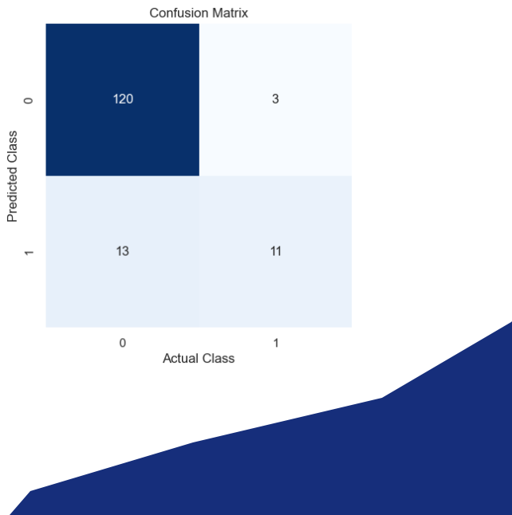
Logistic Regression
Confusion Matrix
Best parameters
C=1
max_iter=100
penalty="l1" solver="liblinear"
Accuracy = 89%

Slide 43
Observations:
The F1 Score and Accuracy metrics might show lower performance due to the
presence of class imbalance, where certain classes dominate the dataset
while others are underrepresented.
By seeing the confusion Matrix , it is visible that the model struggles in
finding the "False Positives" and "False Negatives".
"Support" for "Class 1" is too low which indicates class imbalance.
To improve the model's performance, it is trained on a sufficient dataset with
balanced data.

Slide 44
THANK YOU

